Slide 1
Predictive Maintenance System on AWS
Team Members:
Charan Reddy Kumar
Parameshwar Bhat
Anirudhha

Slide 2
Scope of the project:
Develop a predictive maintenance system that forecasts machine failures by analyzing historical operational data.
The primary goal is to minimize equipment downtime and reduce maintenance costs by proactively identifying potential failures.
The system will utilize AWS Glue for data extraction, transformation, and loading (ETL) processes. Predictions will be generated and stored in Amazon S3 for further analysis and access

Slide 3
About the Dataset
Dataset Overview:
The dataset used for this project comes from a predictive maintenance scenario, where we aim to forecast machine failures based on historical operational data. The dataset consists of 10,000 datapoints, each representing a specific instance of a machine’s operational status, with several features that describe various aspects of its performance and condition.
Dataset link: https://www.kaggle.com/datasets/stephanmatzka/predictive-maintenance-dataset-ai4i-2020

Slide 4
Key Features:
UID: A unique identifier for each datapoint, ranging from 1 to 10,000.
Product ID: A combination of a letter (L, M, or H) representing product quality (low, medium, or high) and a serial number specific to each variant.
Type: The product quality variant (L, M, or H).
Air Temperature (K): Air temperature surrounding the machine, generated using a random walk process and normalized around 300K with a standard deviation of 2K.
Process Temperature (K): The temperature during the machine’s operation, generated using a random walk process normalized to a standard deviation of 1K, added to the air temperature.
Rotational Speed (RPM): The speed of the machine’s rotation, calculated based on a power of 2860W, overlaid with normally distributed noise.
Torque (Nm): The torque applied to the machine, normally distributed around 40 Nm with a standard deviation of 10 Nm.
Tool Wear (min): Time in minutes before the tool experiences wear, with variations based on the product quality (L, M, or H).
Machine Failure: A binary label (0 or 1) indicating whether the machine has failed in the current instance, due to one or more failure modes.

Slide 5
Features implemented
Raw data was securely ingested and stored in Amazon S3, with replication enabled for backup. The data was organized to ensure efficient retrieval and streamlined processing.
AWS Glue was utilized for ETL operations, including data extraction, cleaning, and preprocessing. Feature engineering was applied to create derived features like temperature difference and power, enhancing the data quality for model training.
The processed data was cataloged using AWS Glue’s Data Catalog, enabling seamless access for downstream workflows and machine learning tasks.
Machine learning models were developed using SageMaker’s AutoML feature, which trained and evaluated multiple candidate models. Algorithms such as MXNet and XGBoost were tested, and the best-performing model achieved an accuracy of 99.87%.

Slide 6
The trained model was deployed for batch inference using SageMaker Batch Transform, with all prediction results and outputs stored in Amazon S3 for further analysis.
Amazon CloudWatch was configured to monitor the system’s performance, including tracking model metrics and system health. Alerts were set up to ensure proactive notifications for critical events or anomalies
The combination of these features resulted in a fully automated, reliable, and scalable predictive maintenance system that integrates data ingestion, processing, model training, and monitoring

Slide 7
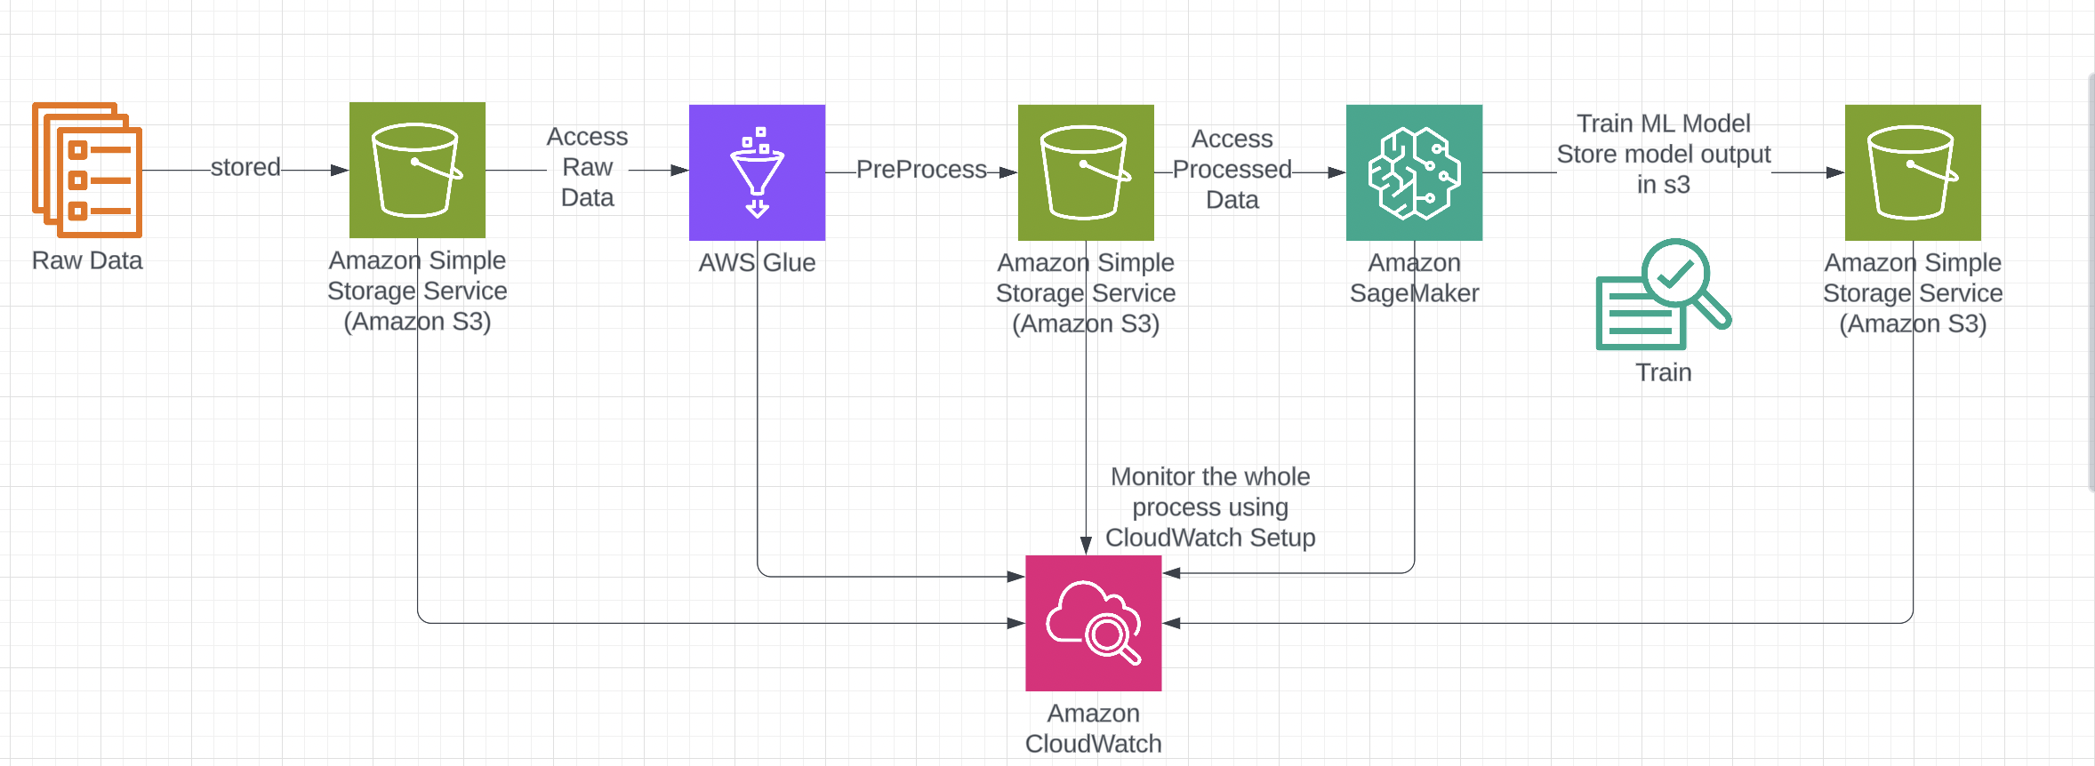
Architecture

Slide 8
Outcomes Achieved
Model Accuracy : The best-performing model, XGBoost, achieved an impressive accuracy of 99.87%, ensuring highly reliable failure predictions.
End-to-End Pipeline: Successfully built an automated, scalable pipeline integrating Amazon S3, AWS Glue, and SageMaker, with CloudWatch for monitoring.
Data Processing Efficiency: Automated ETL pipeline processed and cleaned raw data seamlessly, ensuring high-quality inputs for machine learning.
Proactive Monitoring: Configured CloudWatch alerts ensured the system’s reliability by monitoring performance and triggering notifications for anomalies.
Scalability and Robustness: The system is fully scalable to handle larger datasets and adaptable for real-time predictive capabilities in the future.

Slide 9
Conclusion
This project demonstrates the power of AWS services in building a robust and scalable predictive maintenance system.
By automating the entire pipeline, from data ingestion and processing to model training and deployment, the system minimizes manual intervention while maximizing efficiency.
The 99.87% accuracy achieved by the XGBoost model highlights the potential for such systems to revolutionize operational workflows by preventing unplanned downtimes and optimizing maintenance schedules.
The use of CloudWatch monitoring ensures long-term reliability and quick response to system issues, making the solution practical and production-ready.
Overall, this implementation not only addresses the problem of machine failures but also sets a solid foundation for expanding the system to include real-time analytics and larger datasets.

